Slide 1

Principles of Macroeconomics 3e
Chapter 8 UNEMPLOYMENT
PowerPoint Image Slideshow

Slide 2
Ch.8 OUTLINE
8.1: How Economists Define and Compute Unemployment Rate
8.2: Patterns of Unemployment
8.3: What Causes Changes in Unemployment Over the Short Run
8.4: What Causes Changes in Unemployment Over the Long Run

Slide 3
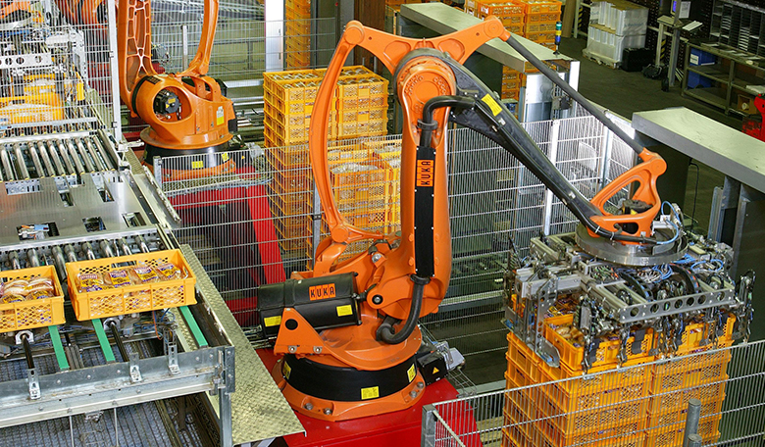
Replaced by Robots
Robots are replacing the jobs historically done by workers in a bread factory. (Credit: modification of "Factory Automation Robotics Palettizing Bread" by KUKA Roboter GmbH/Wikimedia Commons, Public Domain)

Slide 4
8.1 How Economists Define and Compute Unemployment Rate
The adult population consists of:
Employed - currently working for pay.
Unemployed - out of work and actively looking for a job.
Out of the labor force - those who are not working and not looking for work, whether they want employment or not.
also termed “not in the labor force”
Labor force - the number of employed plus the unemployed.
Unemployment rate - the percentage of adults who are in the labor force and thus seeking jobs, but who do not have jobs.
Unemployment rate = Unemployed people x 100
Total labor force

Slide 5
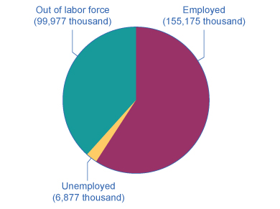
Employed, Unemployed, and Out of the Labor Force Distribution of Adult Population (age 16 and older), January 2021
The total adult, working-age population in January 2021 was 262.029 million.
Out of this total population, 155.175 million were classified as employed, and 6.877 million were classified as unemployed.
The remaining 99.977 million were classified as out of the labor force.
As you will learn, however, this seemingly simple chart does not tell the whole story.
Discussion Question: What is the unemployment rate?

Slide 6
Hidden Unemployment
“Hidden unemployment” - people who are mislabeled in the categorization of employed, unemployed, or out of the labor force.
Part-time or temporary workers looking for full-time or permanent work.
Underemployed - individuals who are employed in a job that is below their skills.
Discouraged workers - those who have stopped looking for employment due to the lack of suitable positions available.

Slide 7
Labor Force Participation Rate
Labor force participation rate - the percentage of adults in an economy who are either employed or who are unemployed and looking for a job.
Labor force participation rate = Total labor force x 100
Total adult population
Discussion Question: Using the November 2021 statistics, what is the labor force participation rate?

Slide 8
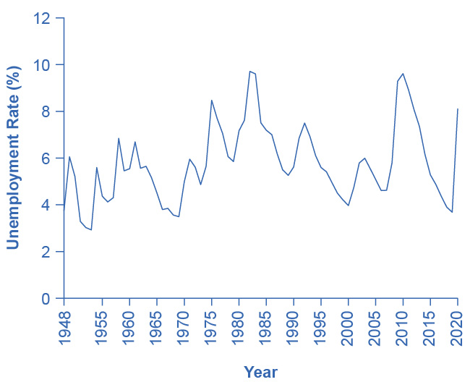
8.2 Patterns of Unemployment
The U.S. unemployment rate moves up and down as the economy moves in and out of recessions.
However, over time, the unemployment rate seems to return to a range of 4% to 6%.
There does not seem to be a long-term trend toward the rate moving generally higher or generally lower. (Source: Federal Reserve Economic Data (FRED), Unemployment Rate (UNRATE), https://fred.stlouisfed.org/series/UNRATE)

Slide 9
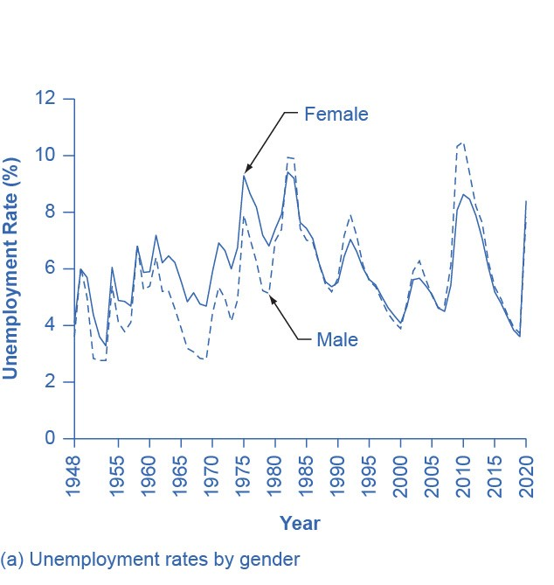
Unemployment Rates by Group - Gender
Unemployment rates for men have historically been lower than unemployment rates for women.
In recent decades, the two rates have been much closer.

Slide 10
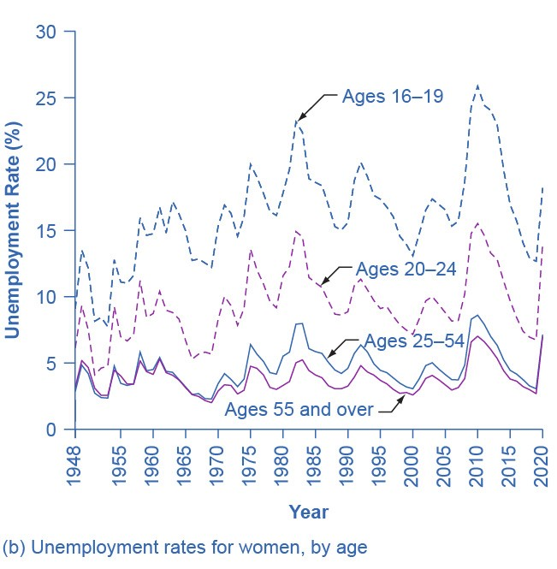
Unemployment Rates by Group - Age
Unemployment rates are highest for the very young and become lower with age. (Source: www.bls.gov)

Slide 11
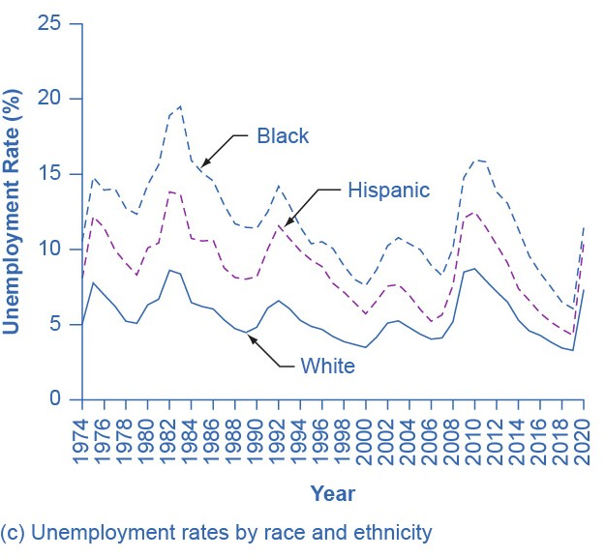
Unemployment Rates by Group - Race and Ethnicity
The unemployment rate for Black people is typically about twice as high as that for White people.

Slide 12
International Unemployment Comparisons
From an international perspective, the U.S. unemployment rate typically has looked a little better than average.
Caution when comparing cross-country unemployment rates due to:
Different definitions of unemployment
Survey tools for measuring unemployment
Poorer countries lack resources and technical capabilities in their statistical agencies.
Different labor markets
In low-income countries, workers are not involved in the labor market through an employer who pays them regularly, but in short-term work, subsistence activities, and barter.

Slide 13
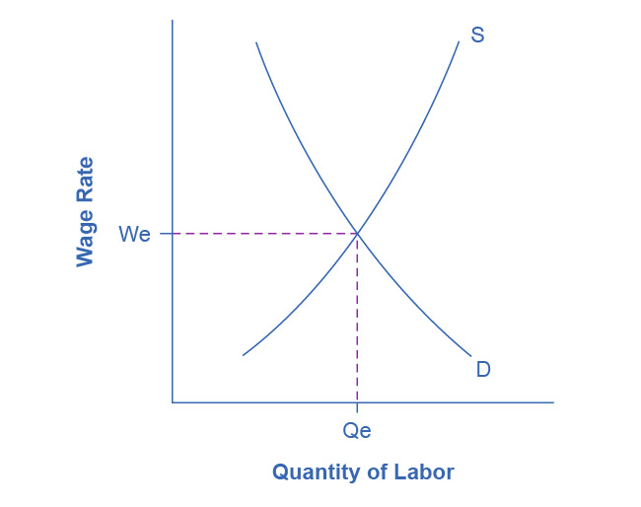
Unemployment and Equilibrium in the Labor Market
In a labor market with flexible wages, the equilibrium will occur at wage W_{e} and quantity Q_{e.}
Here the number of people who want jobs (shown by S) equals the number of jobs available (shown by D).

Slide 14
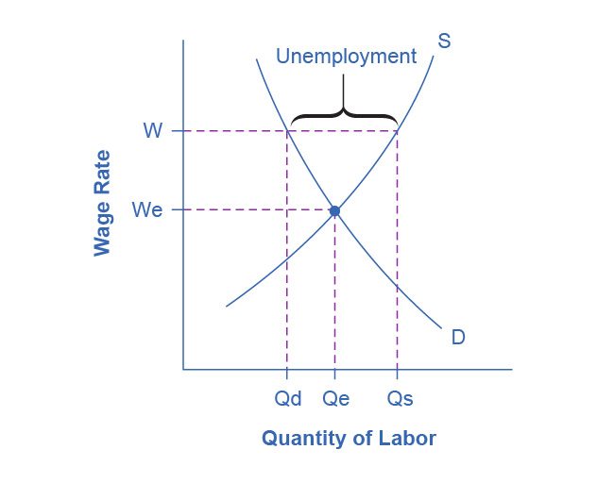
Sticky Wages in the Labor Market
Because the wage rate is stuck at W, above the equilibrium, the number of those who want jobs (Q_{s}) is greater than the number of job openings (Q_{d}).
The result is unemployment, shown by the bracket in the figure.

Slide 15
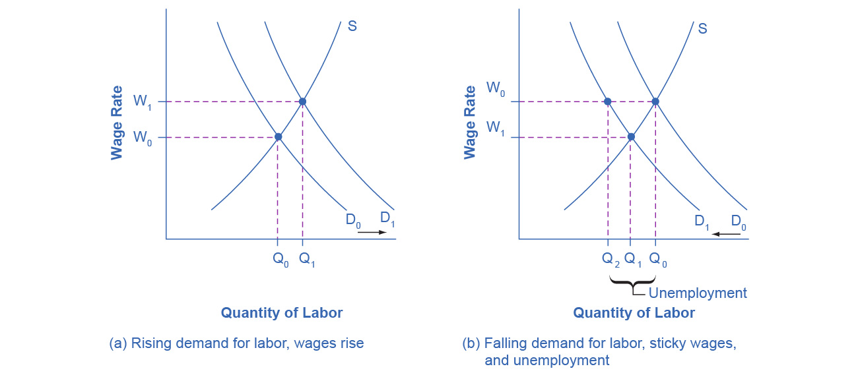
Rising Wage and Low Unemployment: Where Is the Unemployment in Supply and Demand?
(a) In a labor market where wages are able to rise, an increase in the demand for labor from D₀ to D₁ leads to an increase in equilibrium quantity of labor hired from Q₀ to Q₁ and a rise in the equilibrium wage from W₀ to W₁.

Slide 16
Rising Wage and Low Unemployment: Where Is the Unemployment in Supply and Demand?
(b) In a labor market where wages do not decline, a fall in the demand for labor from D₀ to D₁ leads to a decline in the quantity of labor demanded at the original wage (W₀) from Q₀ to Q₂. These workers will want to work at the prevailing wage (W₀), but will not be able to find jobs.

Slide 17
Public Policy and the Natural Rate of Unemployment
On the supply side of the labor market, public policies to assist the unemployed can affect how eager people are to find work.
Unemployment insurance, welfare benefits, food stamps, and government medical benefits may make the opportunity cost of unemployment lower -> a worker may be less eager to seek a new job.
Government assistance for job search or retraining can sometimes encourage people back to work sooner.
On the demand side of the labor market some public policies can affect the willingness of firms to hire:
Government rules
Social institutions
Presence of unions

Slide 18
8.4 What Causes Changes in Unemployment over the Long Run
Three Types of Unemployment:
Cyclical unemployment - unemployment closely tied to the business cycle, like higher unemployment during a recession.
Frictional unemployment - unemployment that occurs as workers move between jobs.
Structural Unemployment - unemployment that occurs because individuals lack skills valued by employers.
Economists consider the economy to be at full employment when the actual unemployment rate is equal to the natural unemployment rate.

Slide 19
The Natural Rate of Unemployment in Recent Years
Natural rate of unemployment - the unemployment rate that would exist in a growing and healthy economy from the combination of economic, social, and political factors that exist at a given time.
Economists consider the economy to be at full employment when the actual unemployment rate is equal to the natural unemployment rate.
Underlying economic, social, and political factors that determine the natural rate of unemployment can change over time, which means that the natural rate of unemployment can change over time too.
Estimates by economists of the natural rate of unemployment in the U.S. economy is about 4.5 to 5.5%, which is a lower estimate than previously.
Reasons for this lower rate:
Internet as a job seeking tool
Growth of the temporary worker industry
Aging of the “baby boom generation”

Slide 21
Why Wages Might Be Sticky Downward, Continued
Insider-outsider model - those already working for the firm are “insiders” who know the procedures; the other workers are “outsiders” who are recent or prospective hires.
Relative wage coordination argument - across-the-board wage cuts are hard for an economy to implement, and workers fight against them.

Slide 22
Why Wages Might Be Sticky Downward
Implicit contract - an unwritten agreement in the labor market that the employer will try to keep wages from falling when the economy is weak or the business is having trouble, and the employee will not expect huge salary increases when the economy or the business is strong.
Efficiency wage theory - the theory that the productivity of workers, either individually or as a group, will increase if the employer pays them more.
Adverse selection of wage cuts argument - if employers reduce wages for all workers, the best will leave.

Slide 23
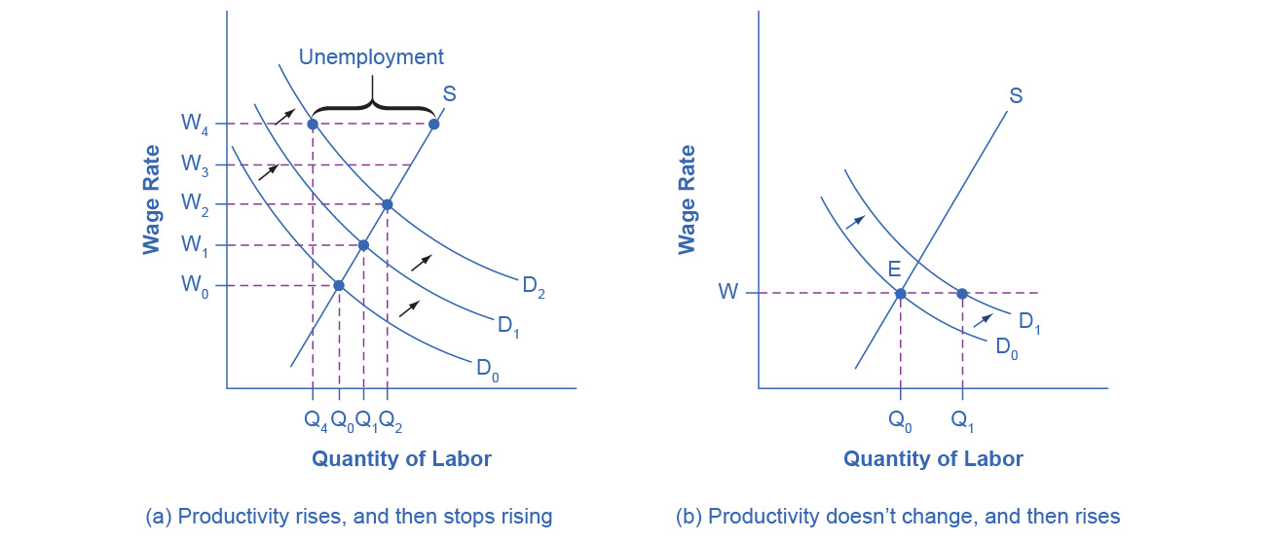
Productivity Shifts and the Natural Rate of Unemployment
The rate of productivity increase has been zero for a time, so employers and workers have come to accept the equilibrium wage level (W).
Then productivity increases unexpectedly, shifting demand for labor from D₀ to D₁.
At the wage (W), this means that the quantity demanded of labor exceeds the quantity supplied, and with job offers plentiful, the unemployment rate will be low.

Slide 24
Productivity Shifts and the Natural Rate of Unemployment
Productivity is rising, increasing the demand for labor. Employers and workers become used to the pattern of wage increases.
Then productivity suddenly stops increasing.
There is a delay or lag in the recognition that productivity is no longer increasing.
As a result, wages keep rising as before, but the demand for labor is no longer increasing, so at wage W₃ and wage W₄, unemployment exists where the quantity supplied of labor exceeds the quantity demanded.

